Slide 1
Financial Data Analysis

Slide 2
Introduction
Financial Data Analysis plays a vital role in understanding an organization’s financial performance and guiding strategic decisions. This project uses Power BI to transform raw financial data into interactive dashboards and visual reports. Through analysis of key metrics like revenue, expenses, and profit margins, it helps identify trends, monitor financial growth, and improve decision-making. Power BI’s visualization tools make it easier to track real-time performance and uncover hidden insights. The main aim is to provide a clear, data-driven view of the company’s financial health, enabling stakeholders to make informed and timely business decisions.

Slide 3
Objectives
To analyze and visualize financial data using Power BI for better understanding of business performance.
To create interactive dashboards that track key metrics such as revenue, expenses, and profit margins.
To identify financial trends, compare results with targets, and highlight areas for improvement.
To transform raw financial data into meaningful insights that support data-driven decision-making.
To provide a clear and comprehensive view of the organization’s financial health, helping management in strategic planning and cost optimization.

Slide 4
Tools and Technologies Used
Microsoft Power BI
Data Cleaning and Transformation
DAX Calculations
Excel Dataset
Data Visualization and Business Analytics Techniques

Slide 5
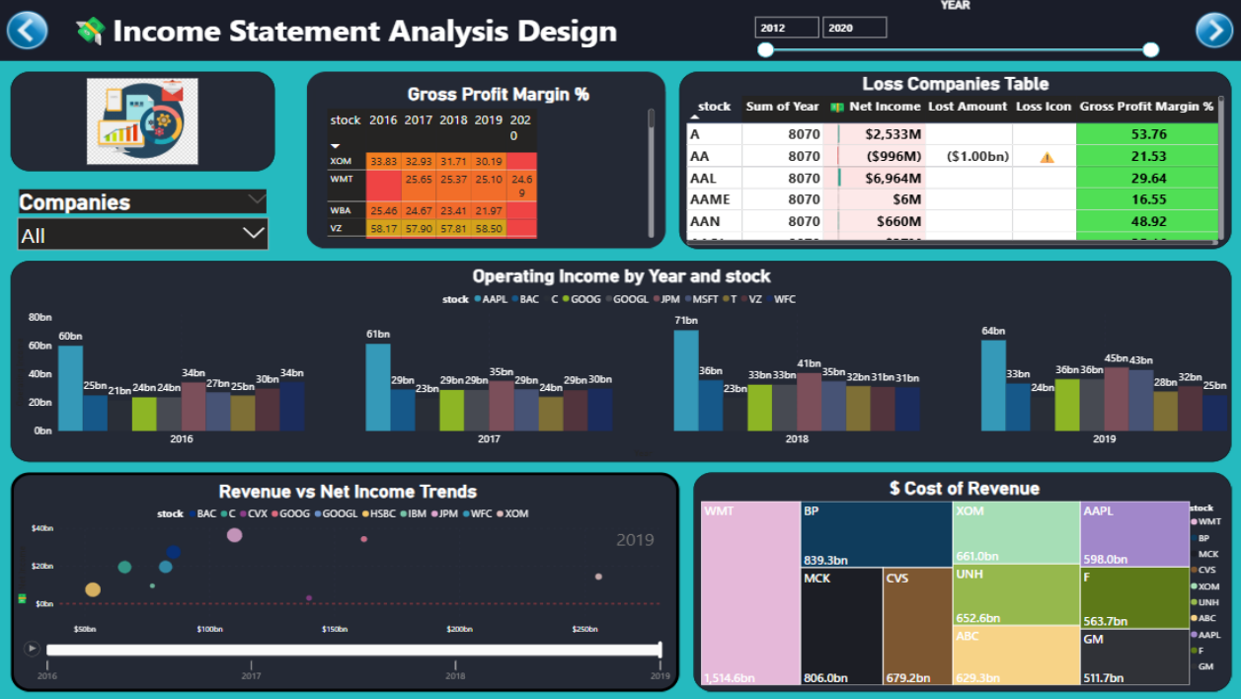

Slide 6
Insights from Income statement focus
The total net income across all companies is 5T, while the cost of revenue stands at 42T, showing high expenditure levels.
Apple (AAPL) leads in both net income and operating income, reflecting strong operational efficiency.
Walmart (WMT) tops the list in total revenue, followed by BP and Exxon (XOM).
Gross profit peaked around 2017–2018 and slightly declined afterward, indicating potential cost pressures.
Overall financial trends after 2016 show stable revenue and income performance across major companies.

Slide 7
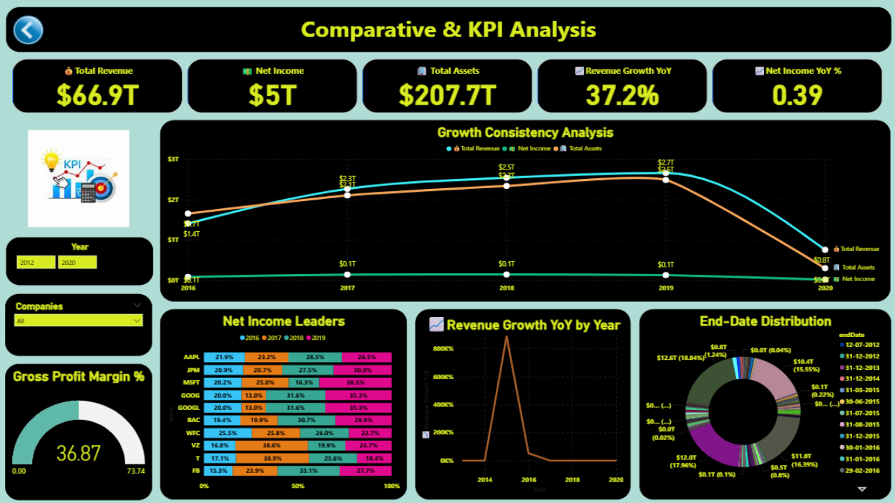

Slide 8
Insights from Comparative & KPI Analysis
Total revenue and total assets show consistent growth from 2015 to 2019, peaking before a drop in 2020.
Net income follows a similar trend, with strong performance between 2017–2019, led by top-performing stocks like AAPL.
The count of stocks increased steadily until 2019, reflecting business expansion and market activity.
Revenue growth correlates positively with increases in total assets, indicating efficient asset utilization.
A slight decline in 2020 suggests possible market contraction or reduced profitability during that period

Slide 9
Summary of Dashboards
The Income Statement Focus dashboard highlights net income, revenue, cost of revenue, gross profit, and operating income trends across major stocks from 2016 to 2020.
It uses line and bar charts to compare financial performance by stock and year, emphasizing growth and profitability metrics.
The Comparative & KPI Analysis dashboard expands the view with total assets, stock count, and multi-metric comparisons from 2014 to 2020.
It enables deeper insights into financial health and stock dynamics using layered visualizations and KPI tracking over time.

Slide 10
Key Business Insights
Revenue and Profit Leadership: Companies like WMT, AAPL, and AMZN consistently lead in total revenue, net income, and retained earnings, signaling strong market performance and operational efficiency.
Asset and Liability Management: WMT and MSFT show high total assets and liabilities, indicating large-scale operations with significant capital structure, while maintaining healthy equity positions.
Cash Flow Dynamics: Operating activities are the primary source of cash for most firms, but capital expenditures remain substantial, especially for asset-heavy companies, impacting overall cash change.
Trend Consistency and Growth: From 2014 to 2020, financial metrics like total revenue, net income, and total assets show upward trends across leading stocks, reflecting sustained growth and strategic expansion.
Risk and Volatility Awareness: Some companies exhibit fluctuations in liabilities and cash flows, highlighting the importance of monitoring financial risks and maintaining liquidity buffers for stability.

Slide 11
Conclusion
The Financial Data Analysis using Power BI project transformed complex financial and customer data into clear, interactive visual insights. It enabled effective monitoring of key metrics such as transaction amounts, account balances, and customer trends. Through Power BI dashboards, the analysis improved financial transparency, identified spending patterns, and supported data-driven decision-making. Overall, it showcased how Power BI enhances financial performance tracking and strategic business planning efficiently.

